Slide 1
Sales Analysis Power BI project Lakshmi

Slide 2

Agenda
Analyze sales patterns at various geographic levels using Power BI slicers
Analyze sales and orders by month and year using Power BI slicers
Design a customizable dashboard with interactive elements

Slide 3
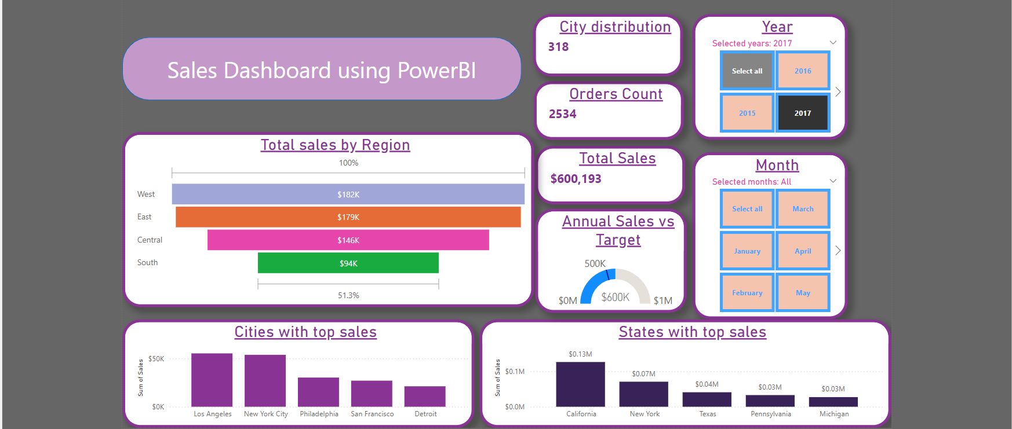
Analysis of yearly/monthly sales and orders, identifying Top 5 key performing Cities, States by using filters. Cards used to highlight Total Sales, Order Count, Annual Sales vs target. Usage of Funnel, Bar charts, Slicers.

Slide 4
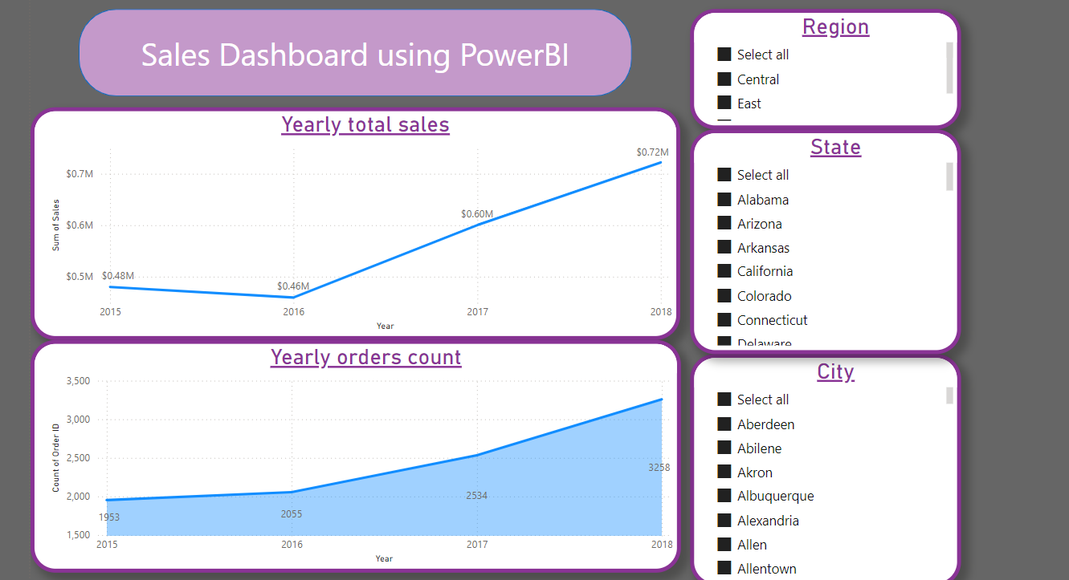
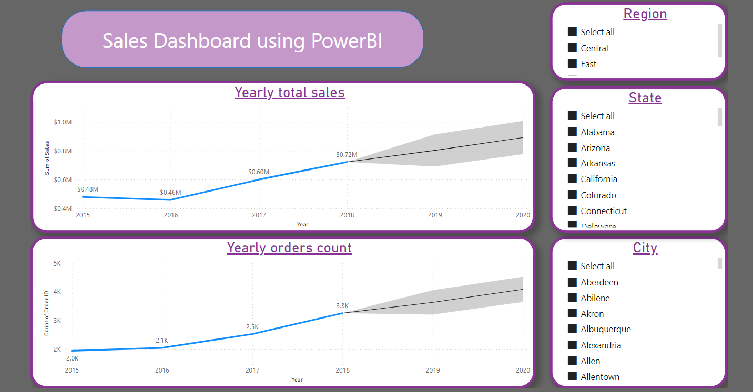
Analyze and forecast sales and orders, drilling down to the region, state, and city levels for the next few quarters.

Slide 5

Thank you

